Slide 1

Seminar: FACE DETECTION
Pattern Recognition
Indicator: Huu-Phuoc Phan, Nhat-Truyen Nguyen,
Minh-Dat Nguyen, Hoang-Phuoc Nguyen

Slide 2
Table of contents
1
2
3
4
5
01
Problem Statement
Literature Review
Proposed Method
Experiment
Conclusion

Slide 3
01
Problem Statement
02
Face Detection

Slide 4

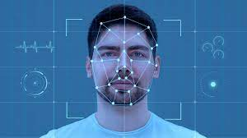
Definition
Application
03
Face Detection | Problem Statement
Face Detection is a computer vision task.
It involves automatically identifying and locating human faces within images or videos.
It is a fundamental technology that underpins many applications such as face recognition, face tracking, and facial analysis.

Slide 5
02
Literature Review
04
Face Detection

Slide 6
Early efforts
05
Face Detection | Literature Review
Mainly based on the classical approach, in which hand-crafted features were extracted and were fed into a classifier.
Haar Cascades classifier | P. Viola and M. Jones, "Rapid object detection using a boosted cascade of simple features," Proceedings of the 2001 IEEE Computer Society Conference on Computer Vision and Pattern Recognition. CVPR 2001
Histogram of Oriented Gradients (HOG) + SVM | N. Dalal and B. Triggs, "Histograms of oriented gradients for human detection," 2005 IEEE Computer Society Conference on Computer Vision and Pattern Recognition (CVPR'05)

Slide 7
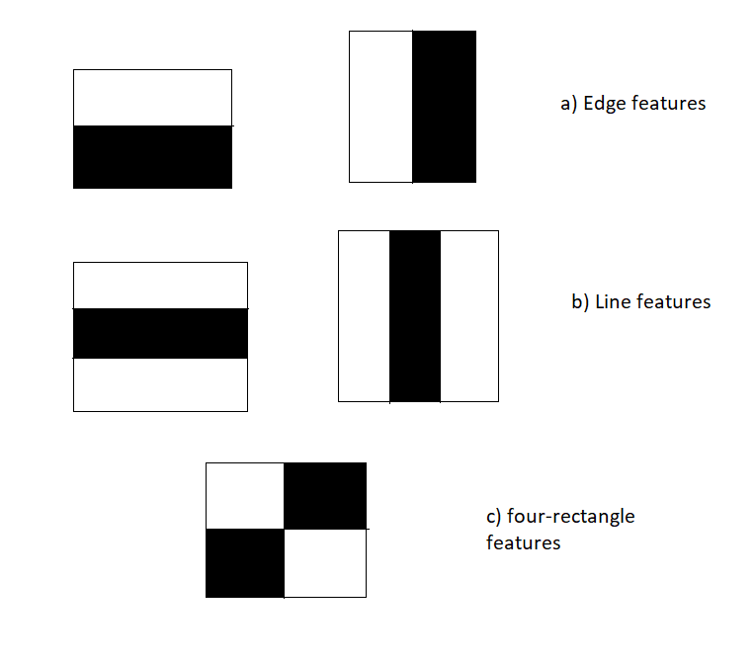
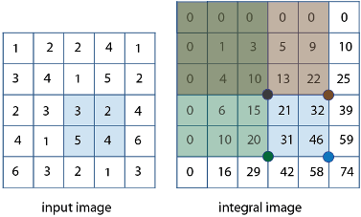
Haar feature & Integral image
06
Face Detection | Literature Review
The integral image at location x, y contains the sum of the pixels above and to the left of x, y.
Using the integral image, any rectangular sum can be computed in four array references.
Haar-like feature can be viewed as a mask consisting of three values:
1 for those pixels in the white region of the feature.
−1 for those dark region pixels in the feature.
0 for those pixels outside of the feature region.

Slide 8
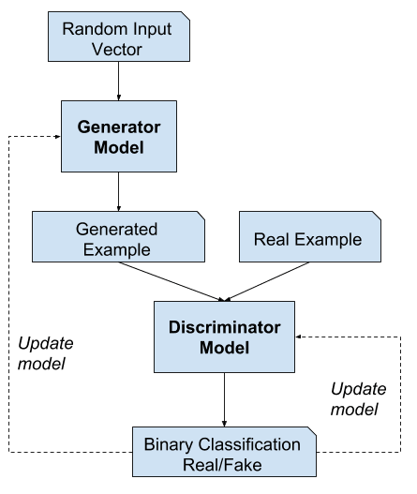
Deep Learning-based Approach
07
Face Detection | Literature Review
With the great success of deep learning in computer vision, researchers have proposed several promising model architectures.
CNNs | Some of the most well known CNN architectures include AlexNet, VGGNet, and ResNet.
R-CNN Based Models | Some of the most well known are R-CNN, Fast R-CNN and Faster R-CNN.
GANs | GANs consist of two networks—a generator (G) and a discriminator (D). D tries to minimize its classification error in distinguishing fake samples from real ones, and G tries to maximize the discriminator network’s error.

Slide 9
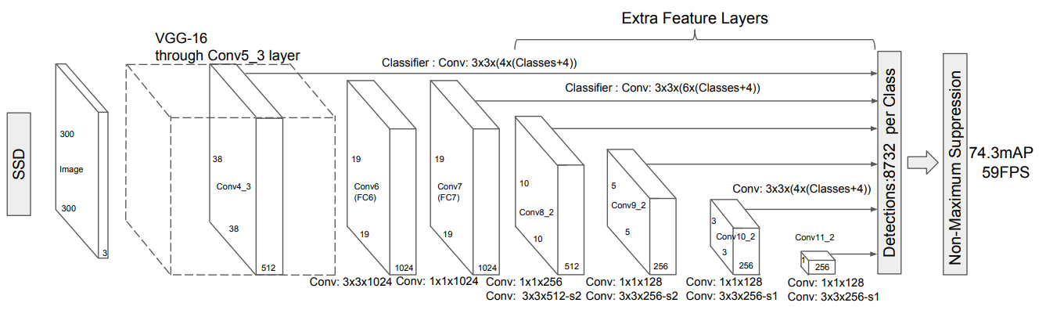
Deep Learning-based Approach
08
Face Detection | Literature Review
The Single Shot Detector (SSD) | SSD achieves real-time object detection through a single-pass design with a single neural network. This makes it faster than other models by eliminating the need for a separate region proposal step, while still maintaining good accuracy through the use of multiple bounding boxes of various sizes.

Slide 10
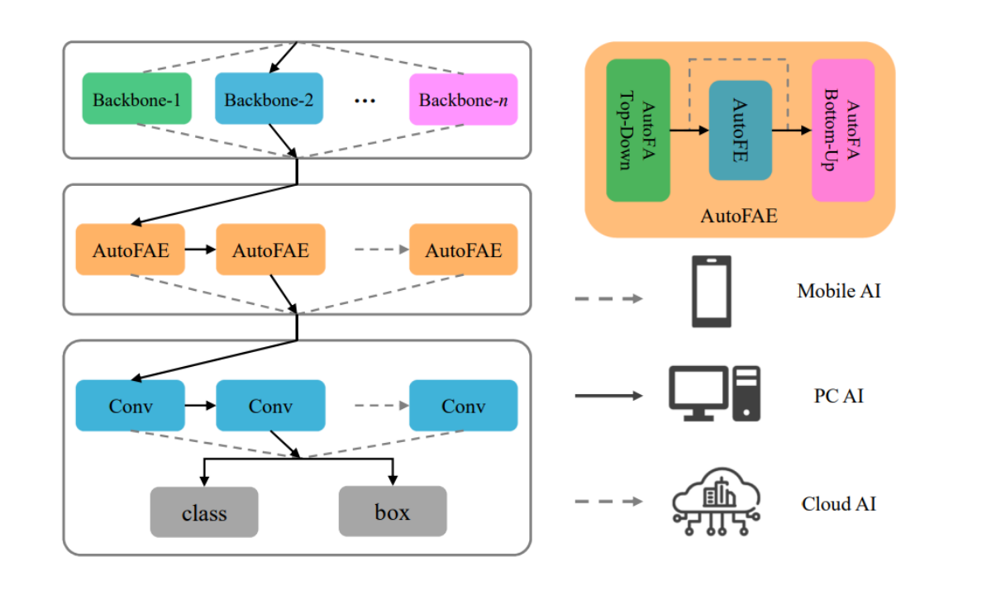
SOTA Method
09
Face Detection | Literature Review
ASFD: Automatic and Scalable Face Detector (2021) | CNN Backbone for Feature Extraction. Neural Architecture Search (NAS) for Optimal Network Design. AutoFAE for Feature Aggregation and Enhancement.
Workflow:
The CNN backbone extracts feature maps from the input image.
The AutoFAE module performs FA and FE on the extracted feature maps, enhancing their quality and discriminative power.
The enhanced feature maps are fed into the main neural network for face detection.
By leveraging NAS, ASFD could achieve higher accuracy compared to existing methods. However, NAS can be computationally expensive as they explore a vast search space of network architectures.
https://doi.org/10.1145/3474085.3475372

Slide 11
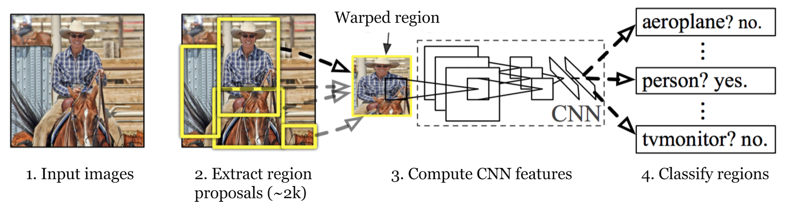
R-CNN Architecture
10
Face Detection | Literature Review
Selective search is an algorithm to provide region proposals that potentially contain objects.
Use image segmentation to create regions.
Iteratively group similar regions together.
Repeat until the whole image becomes a single region.

Slide 12
R-CNN versus Fast R-CNN
R-CNN:
Fast R-CNN
11
Face Detection | Literature Review
Can be divided into 2 phases:
Phase 1: Use selective search to find region of interest (ROI).
Phase 2: Extract CNN features from each region for classification.
The feature is consumed by a binary SVM trained for each class.
The positive samples are proposed regions with IoU over certain threshold.
Observations:
Many region proposals of the same images are highly overlapped.
Modifications:
Instead of extracting features independently for each region proposal, this model aggregates them into one CNN forward pass over the entire image.
Pros:
Improved processing speed.

Slide 13
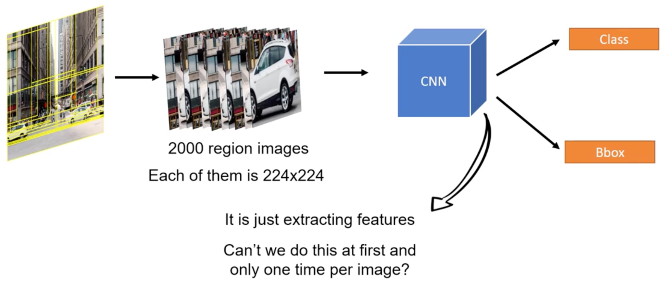
R-CNN
12
Face Detection | Literature Review
Training an R-CNN model is expensive and slow due to the separate proposal generation step!
Image source: Fast R-CNN: Everything you need to know from the paper

Slide 14
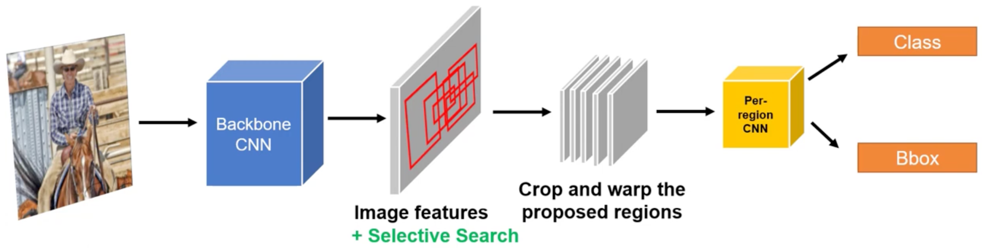
Fast R-CNN
13
Face Detection | Literature Review
Fast R-CNN still used selective search but ran the deep learning network on the entire image first. Then, only the proposed regions were extracted and further processed for classification and bounding box refinement.
Image source: Fast R-CNN: Everything you need to know from the paper

Slide 15
03
Proposed Method
14
Face Detection

Slide 16
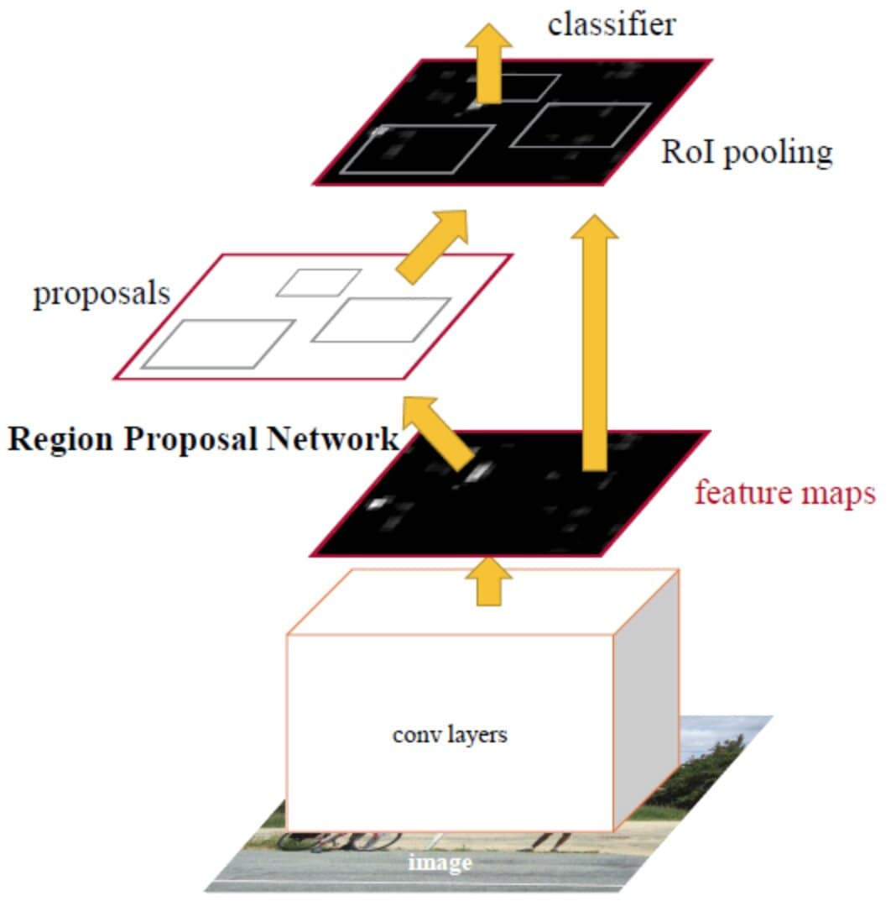
Faster R-CNN
15
Face Detection | Proposed Method
Built upon R-CNN and Fast R-CNN.
Perform region proposal and classification on the same feature map.
Use a neural network for region proposal.
→ Improved efficiency compared to prior architectures.

Slide 17
Three networks of Faster R-CNN
16
Face Detection | Proposed Method
Feature Extraction
Region Proposal
Detection Network
Generate features from images.
Generate Region of Interests (ROIs).

Slide 18
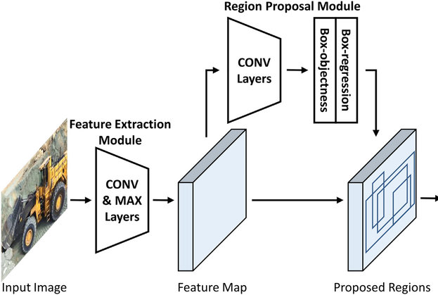
Feature Extraction
17
Face Detection | Proposed Method
Functionality: generate features from images.
Pretrained models:
ResNet or VGG.
Pretrained on large image dataset (e.g. ImageNet).
Convolutional layers:
Use filters that perform convolution operations as it is scanning the input image.
Feature map:
Tensor output of convolutional layers, each element represents a feature.

Slide 19
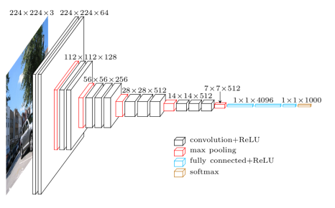
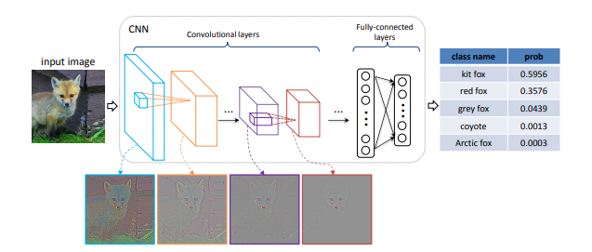
VGG (Visual Geometry Group)
Deeper networks improve model accuracy.
18
Face Detection | Proposed Method
CNN architecture with multiple layers
VGG-16 (16 convolutional layers)
VGG-19 (19 convolutional layers)
Multiple CNN layers + max pooling, instead of interleaving.
Activation ReLU: θ(x) = max(0, x).
Replaces large filters with multiple 3×3 filters → improving significantly.
VGG-16 has a parameter count of up to 138 million parameters. It is one of the networks with the largest parameter counts. Its performance ranks second on the ImageNet dataset at the time of publication.

Slide 20
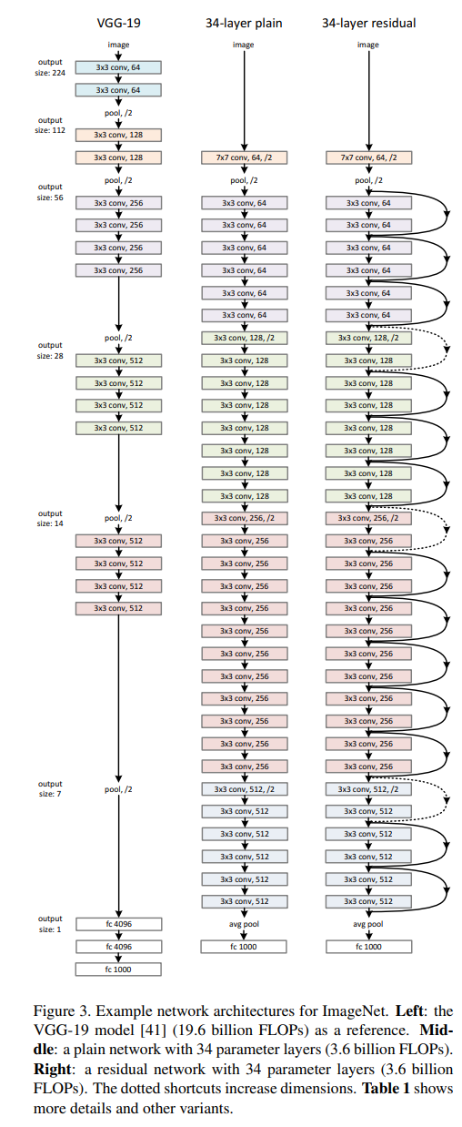
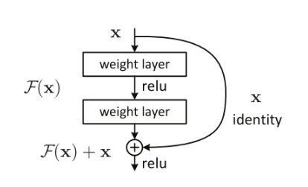
ResNet (Residual Network)
ResNet is designed to work with multiple layers
19
Face Detection | Proposed Method
Problem:
Vanishing Gradient: ReLU reduces Vanishing Gradient, but issue persists in deep models.
Exploding Gradient: ReLU is not bounded.
Solution:
Skip connection: Create direct connections between layers at different depths in the network. This forms a Residual block.
→ Information can skip intermediate layers to reach subsequent layers.
Resnets are made by stacking these residual blocks together.
The image is extracted from:
Deep Residual Learning for Image Recognition(2015) Kaiming He, Xiangyu Zhang, Shaoqing Ren, Jian Sun
Microsoft Research
Despite being much deeper than VGG-16, ResNet50's parameter count is only around 26 million.

Slide 21
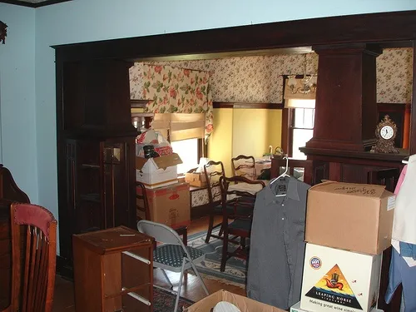
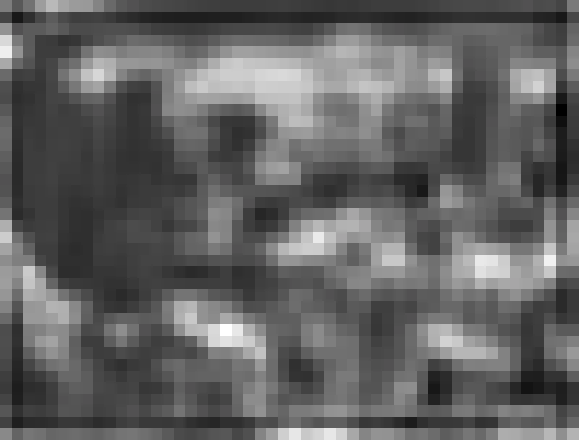
Input - Output
20
The feature was generated by collapsing the 3rd dimension into one number, the other 2 dimensions were scaled to the size of the original picture.

Slide 22
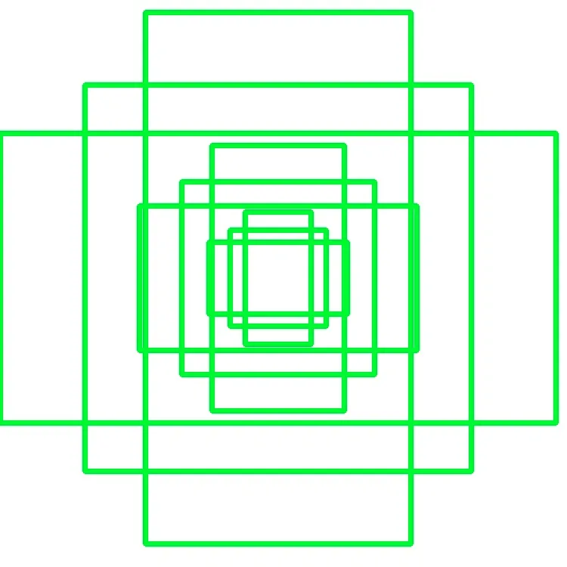
Region Proposal Network
21
Instead of using selective search like Fast RCNN, RPN uses a small neural network to extract the proposal regions.
Let's explore the concept of anchor boxes.
Anchor boxes
Every ‘pixel’ of the feature image is an anchor. Boxes of different shapes and sizes are generated centered on each anchor.
Each anchor is like a sliding window in Fast RCNN, but instead of searching on every combination of sliding window at each pixel, we use 2 neural networks to identify if this anchor meets the standard of a “proposal region”.

Slide 23
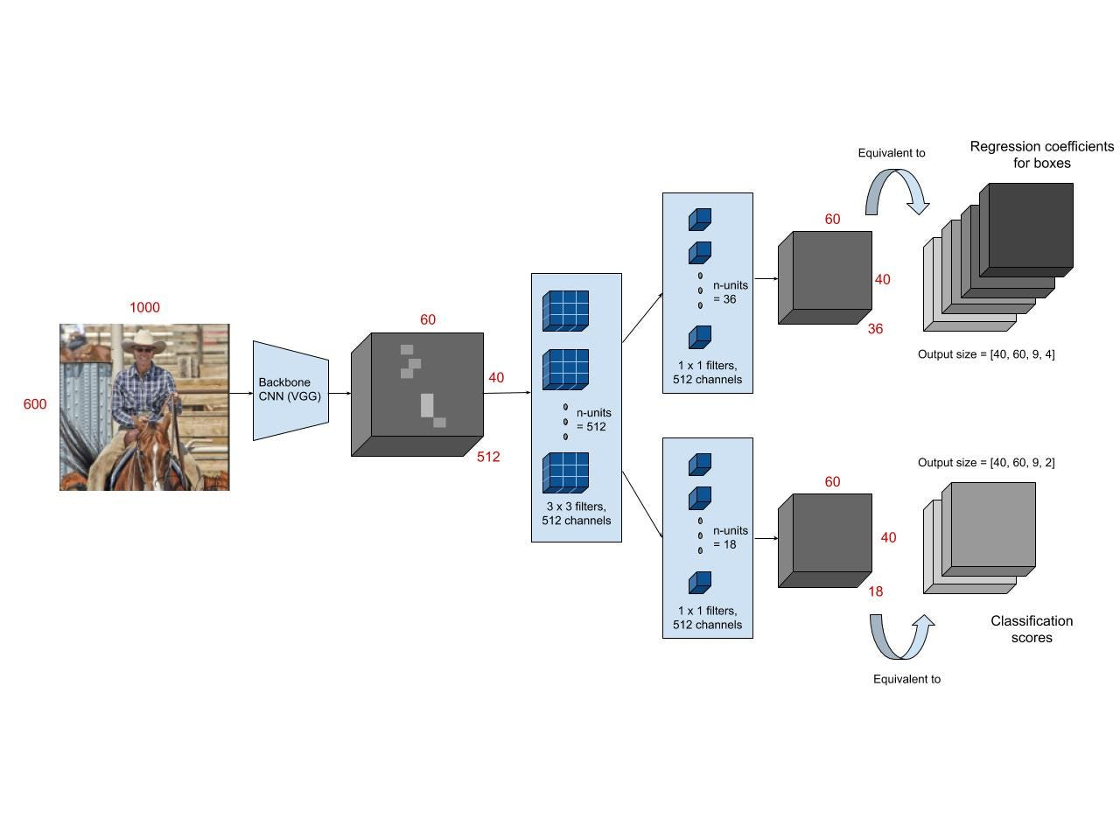
RPN Architecture
22
Regression layer:
Regress the "position" of the anchor box. Output a 4D vector representing the coordinates of the anchor box.
Classification layer:
Predict the "probability" of containing an object in the anchor box.

Slide 24
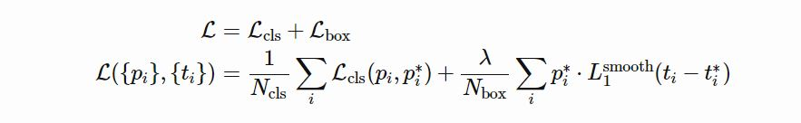
Loss function
23
p_i is the predicted probability of anchor i being an object.
p_i* is the ground truth label whether anchor i is the object.
t_i is a 4D vector representing the predicted bounding box coordinates.
t_i* is a 4D vector representing the ground-truth bounding box coordinates.
The first term is the classification loss over 2 classes (There is object or not).
The second term is the regression loss of bounding boxes only when there is object

Slide 25
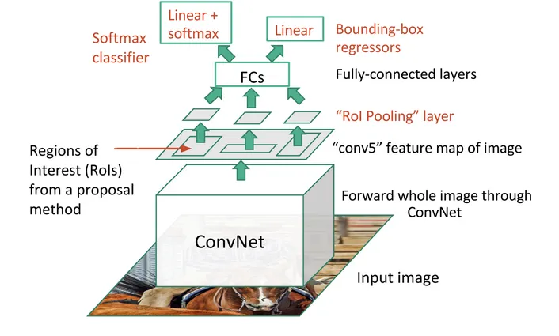
ROI Pooling
24
RoI pooling layer, a Spatial pyramid Pooling (SPP) technique is the main idea behind Fast R-CNN and the reason that it outperforms R-CNN in accuracy and speed respectively
It addresses the challenge of processing Regions of Interest (ROIs) with varying sizes within a fixed-size framework for classification and bounding box regression.

Slide 26
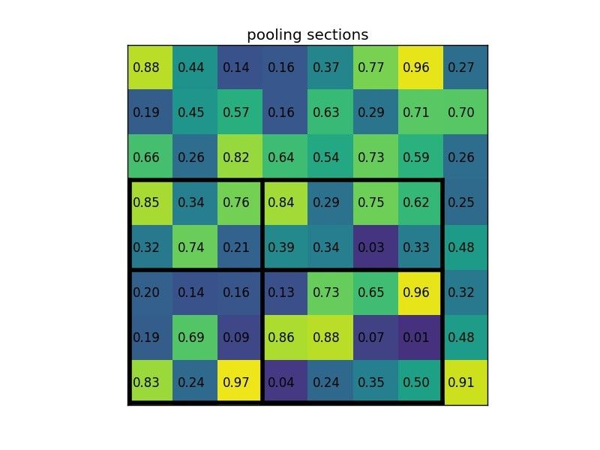
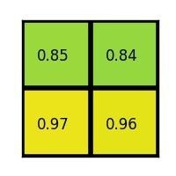
ROI Pooling
25
The ROI is divided into a grid of smaller sub-regions (e.g., 7x7).
For each sub-region:
The maximum value (max pooling) is extracted from the corresponding area in the feature map.
This process results in a fixed-size output feature map for each ROI, even though the original ROIs had different sizes.
Output

Slide 27
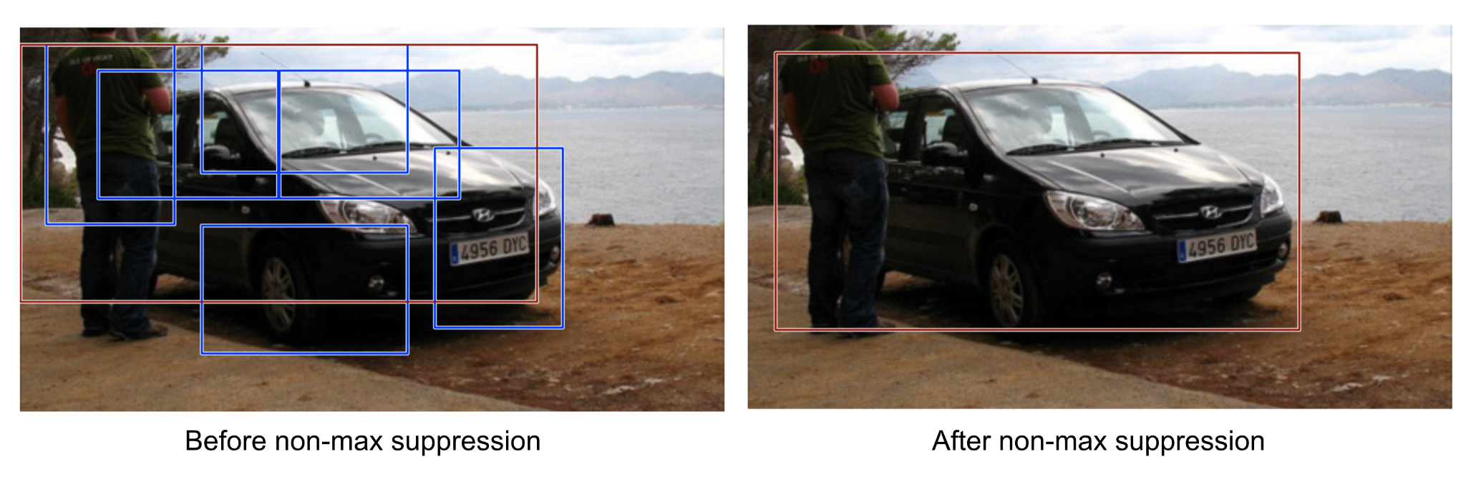
Non-Maximum Suppression
26
Given a set of bounding boxes for the same category:
Sort the bounding boxes by confidence score.
Discard boxes with low confidence scores.

Slide 28
04
Experiment
27
Face Detection

Slide 29

Dataset
Implementation
28
Face Detection | Experiment
Human Faces (Object Detection)
Source: Kaggle
Structure:
Image folder
Annotation file (.csv)
2204 unique images
3350 facial regions
Encompassing various races, age groups, and profiles, ect
Detectron2 is Facebook AI Research's library that provides state-of-the-art detection and segmentation algorithms.
It provides a large set of baseline results and trained models available for download in the Detectron2 Model Zoo.

Slide 30
Detectron2 - Notable features
29
Face Detection | Experiment
DatasetCatalog: A global dictionary that stores information about the datasets and how to obtain them.
It maps from strings (dataset names) to a function which parses the dataset and returns the samples.
The purpose is to choose different datasets easily by using the strings in the config.
DefaultTrainer: “trainer” abstraction that simplifies the training behavior.
It includes standard behaviors (optimizer, LR schedule, evaluation, etc).

Slide 31
Training parameters
Hardware config
30
Face Detection | Experiment
Base learning rate: 0.001
# unique images: 400
# images per training batch: 4
# iterations for the warm-up phase: 600
# iterations for training: 900
# ROI proposals per image: 64
# classes: 2
Steps at which the learning rate is reduced: (600, )
Factor by which the learning rate is reduced at each step (gamma): 0.05
Runtime type: Google Colab T4 GPU
System RAM: 12.7 GB
GPU RAM: 15.0 GB
Disk: 78.2 GB

Slide 32
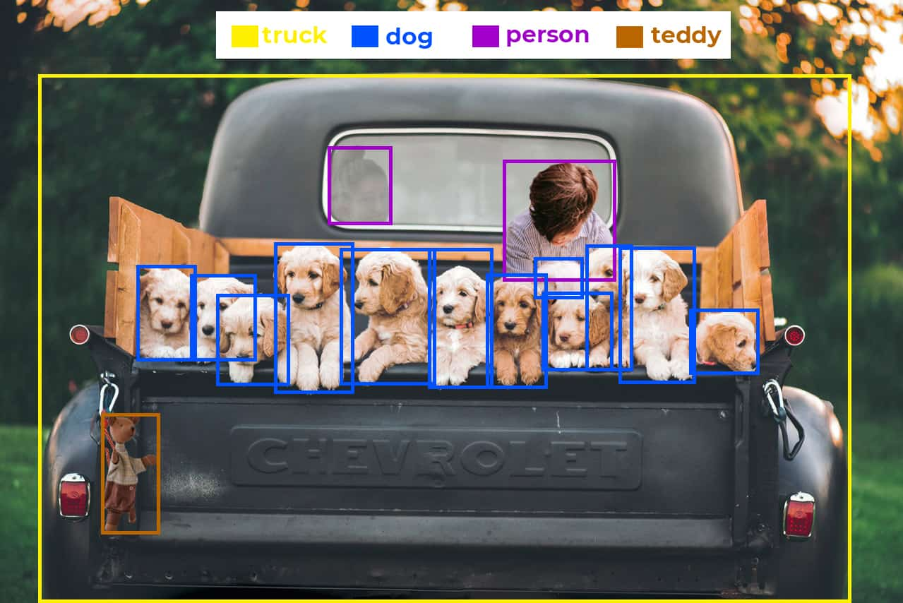
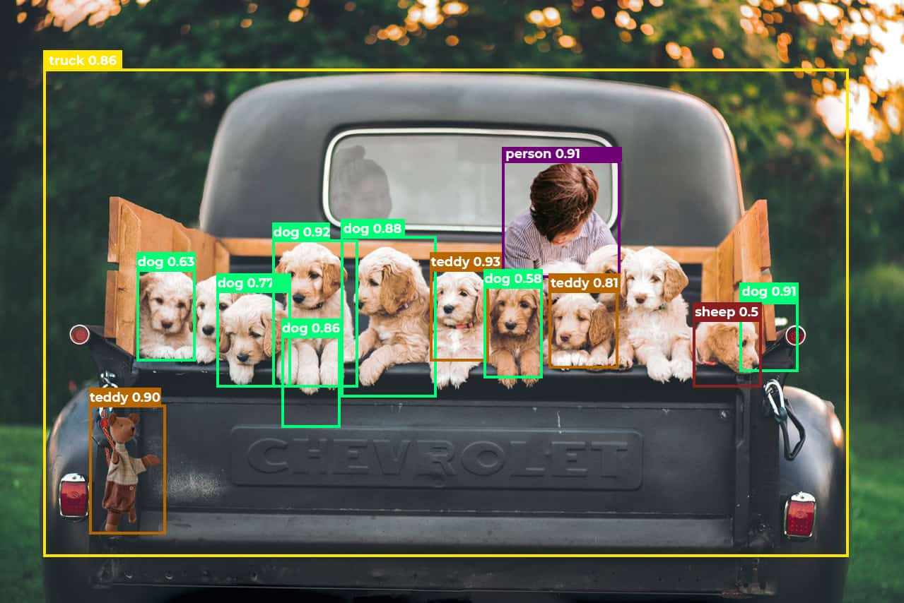
Metric: Average precision
16
Face Detection | Experiment
AP (Average precision) is the area under the precision-recall curve.
A precision-recall curve is a graph with Precision on the y-axis and Recall on the x-axis.
Example: Ground truth (right) and Prediction (left)

Slide 33
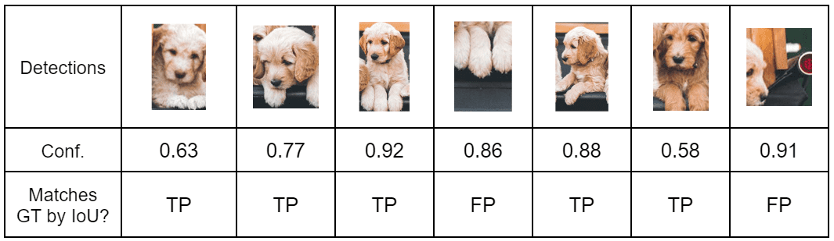
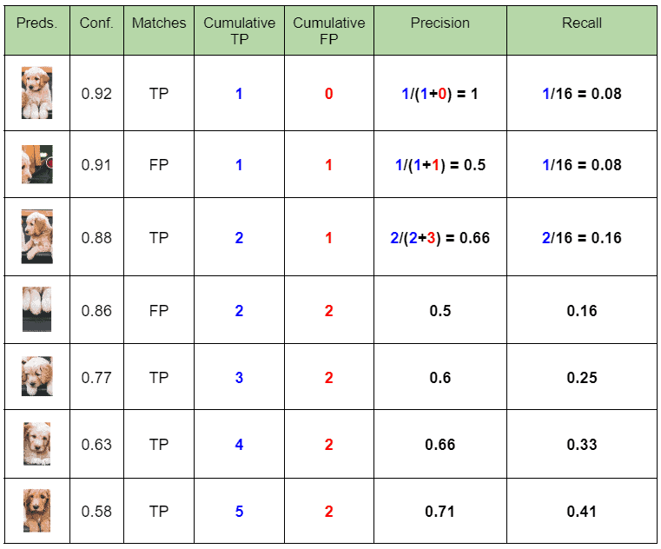
Metric: Average precision
32
Face Detection | Experiment
Record every Dog detection
Calculate Precision and Recall

Slide 34
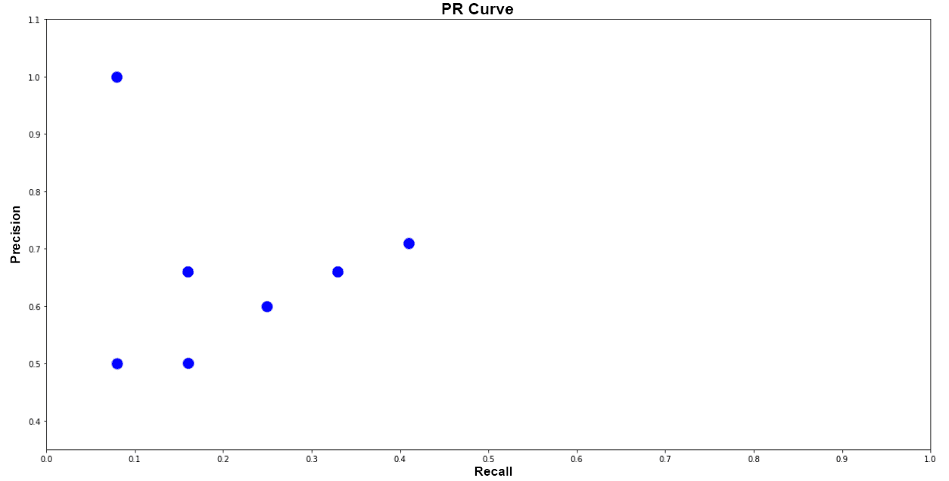
Metric: Average precision
33
Face Detection | Experiment
Plot Precision-Recall graph

Slide 35
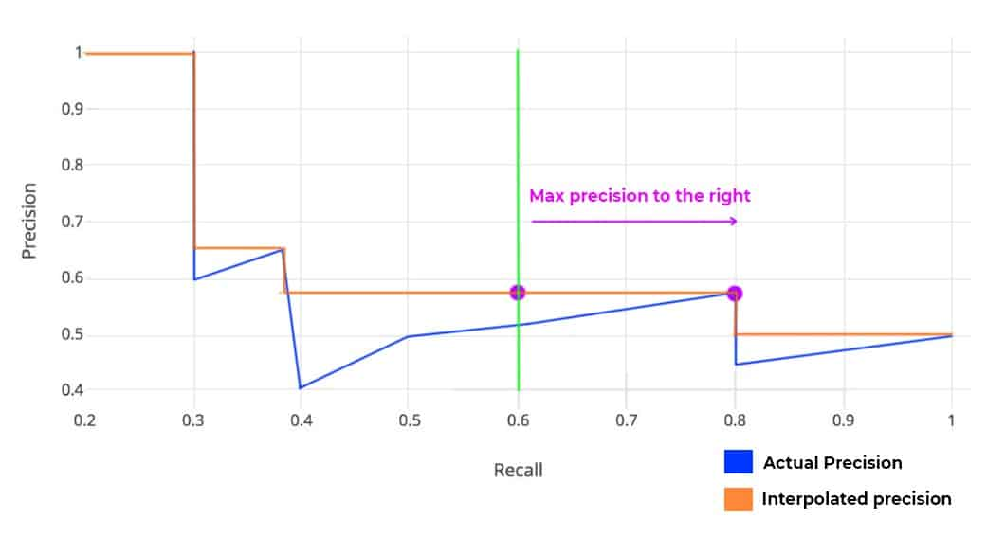
Metric: Average precision
34
Face Detection | Experiment
Calculate Average Precision (AP) using PASCAL VOC 11 Point Interpolation Method

Slide 36
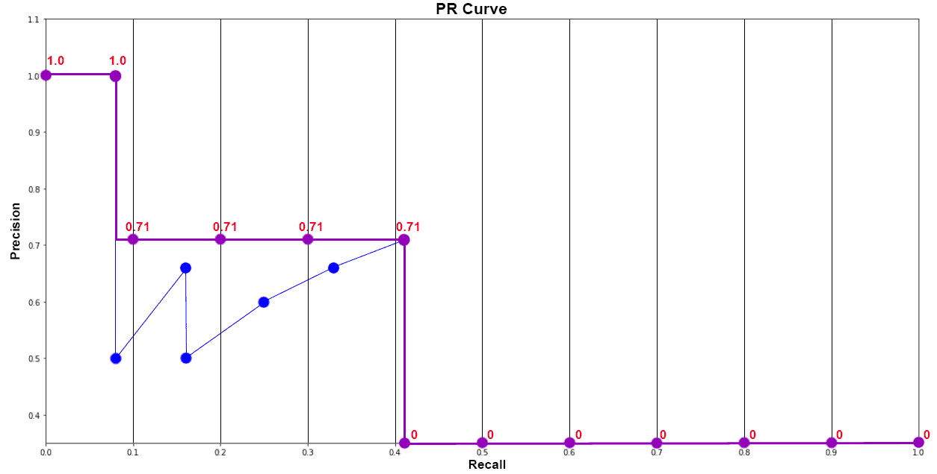
Metric: Average precision
35
Face Detection | Experiment
Plot Final Interpolated graph and calculate Average Precision for Dog Class
AP_{dog}
= 1/11 * (1 + 4*0.71 + 6*0)
= 0.349

Slide 37
Experimental Results
36
Face Detection | Experiment
 | Faster R-CNN | Mask R-CNN
AP | 31.173 | 34.541
AP50 | 84.154 | 84.404
AP75 | 9.602 | 28.779
APm | 28.531 | 18.057
APl | 32.942 | 46.336
Faster R-CNN has lower results but still exhibits strengths in certain areas:
AP50 score of 84.15% indicates that Faster R-CNN achieves a high precision rate with an IoU threshold of 0.5.
APm and APl scores of 28.53% and 32.94% respectively indicate that the model performs reasonably well in detecting and localizing medium and large objects.

Slide 38
05
Conclusion
37

Slide 39
Key features
Comparisons
38
Face Detection | Conclusion
Faster R-CNN is a two-stage object detection model that:
Employs a pre-trained CNN for feature extraction and a Region Proposal Network (RPN) to efficiently identify candidate object regions.
ROI pooling then extracts fixed-size features from these regions for classification and bounding box refinement.
While achieving a lower overall average precision compared to Mask R-CNN on a human faces dataset, Faster R-CNN demonstrates strengths in high precision for detections with a 0.5 IoU threshold and reasonable performance in detecting medium and large objects. This balance between accuracy and speed makes Faster R-CNN a valuable tool for various object detection tasks.

Slide 40
The end
Thank you for listening and feel free to ask any questions.

